Slide 1

Volume of Rectangular Prisms

Slide 2
24
7
30
Topic: Volume
Date
EQ – How do we find the volume of Rectangluar Prisms?
Volume
Volume measures the space inside a solid shape.
Cubic units are used for volume.

Slide 3
Right Prisms
A right prism is a geometric solid that has a polygon as its base and vertical sides perpendicular to the base. The base and top surface are the same shape and size.
Polygon – Many sided shape (octagon, hexagon…)
Click on the link to see some examples of different types of right prisms
http://www.learner.org/interactives/geometry/3d_prisms.html

Slide 4
VOLUME
VOLUME is the amount of liquid or solid that will FILL a 3-Dimensional object!
*Always measured in units cubed (u³)

Slide 5
QUICK DEFINITION
3-Dimensional objects are NOT FLAT.
They have 3 measurements:
Length
Width
Height

Slide 6
What Does Volume Mean?
Click on the link to explore the concept of volume
http://www.learner.org/interactives/geometry/area_volume.html

Slide 7
Volume – the amount of space occupied by an object.
Example:
The VOLUME of this cube is all the space contained by the sides of the cube, measured in cube units (units³).
h
w
l

Slide 8
Volume – To calculate the volume of a prism, we first need to calculate the area of the BASE of the prism.
Example: The AREA of the base of this rectangular prism is l x w.
h
w
l

Slide 9
Volume – Once we know the area of the base, this is then multiplied by the height to determine the VOLUME of the prism.
We find that:
Volume = Area of Base x Height
Volume = (l x w) x h
h
w
l
*Pro tip: Don’t just multiply all the numbers together. Find the area of the base and multiply by the height. This will make finding the volume of other prisms much easier if you learn this way.

Slide 10
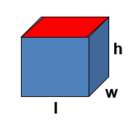
24
7
30
Topic: Volume
Date
EQ – How do we find the volume of Rectangluar Prisms?
Volume
Volume measures the space inside a solid shape.
Cubic units are used for volume.
Volume = Area of Base x Height
Volume = (l x w) x h

Slide 11
Volume (rectangular prism)
Formula:
V = B x h
V = l x w x h
h
w
l

Slide 12
Find the volume of this prism…
Formula:
V = B x h
V = l x w x h
7 cm
4 cm
5 cm

Slide 13
Find the volume of this prism…
Formula:
V = B x h
V = l x w x h
V = 5cm x 4cm x 7cm
7 cm
4 cm
5 cm

Slide 14
Find the volume of this prism…
Formula:
V = B x h
V = l x w x h
V = 5cm x 4cm x 7cm
V = 140cm³
7 cm
4 cm
5 cm

Slide 15
Does it matter which side is the base?
Formula:
V = B x h
V = l x w x h
V = 7cm x 4cm x 5cm
5 cm
4 cm
7 cm

Slide 16
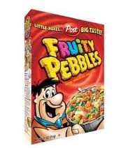
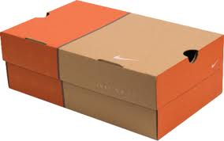

RECTANGULAR PRISM
A RECTANGULAR PRISM, is a solid figure that has six faces that are all rectangles. Opposite faces are congruent and parallel.

Slide 17
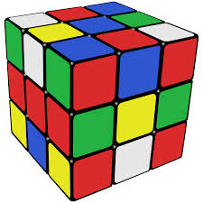

Cube
A CUBE, is a solid figure that has six faces that are all squares. All faces are congruent and parallel. This shape is classified as a rectangular prism because all squares are technically rectangles

Slide 18
FIND THE VOLUME OF THIS RECTANGULAR PRISM:
3 mm
2 mm
12 mm

Slide 19
FIND THE VOLUME OF THIS RECTANGULAR PRISM:
4 in
10 in
3 in

Slide 20
FIND THE VOLUME OF THIS RECTANGULAR PRISM:
11 in
40 in
9 in

Slide 21
FIND THE VOLUME OF THIS RECTANGULAR PRISM:
8 m
8 m
8 m

Slide 22
FIND THE VOLUME OF THIS RECTANGULAR PRISM:
5 cm
5 cm
5 cm

Slide 23
A cereal box has a length of 25cm, a width of 8cm, and a height of 36cm? How much cereal will the box hold?

Slide 24
Wordtoon
b

Slide 25


Slide 26
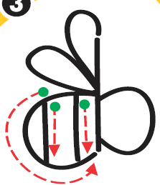

Slide 27


Slide 28
Alexia’s bathroom has a tub in the shape of a rectangular prism with a length of 1.5 metres, a width of 0.5 metre, and a height of 0.4 metre. How many cubic metres of water can it hold?

Slide 29
Trailers that travel on the road behind trucks are rectangular prisms. A typical height for the inside of these trailers is 3m. If the trailer is 2.5m wide and 12.3m long, what is the volume of the trailer?

Slide 30
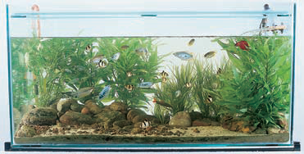
An aquarium shaped like a rectangular prism has a length of 120 centimetres, a width of 60 centimetres, and a height of 100 centimetres. How much water is needed to fill the aquarium?

